Slide 1

Home Page
Navigation Bar
SupplyCompass
BRINGING MANUFACTURERS AND DESIGNERS TOGETHER
I’m want to manufacturer….
….....................

Slide 2
We can help you
Tell us more so we can customise your experience
Are you a
Individual
Start Up
Small Business
Big Brand

Slide 3
Home Page
Our Process
About Your Brand
Design Development
Factory Matching
Production
Company Values
Order Quantities
Budget
Details
Patterns
Materials
Illustrations
Factory Matching
Competitive Quotes
Samples
Shipping
Brand Image
Future Orders
Tracking
Outputs:
Your Compass
Tech Pack
Trusted Partner
Delivered Goods

Slide 4
Home Page
Our 6 Stage Process
About Your Brand
Design Development
Factory Matching
Production
Product
Type
No. of Styles
Target Market
Collarless Shirts
Order Quantities
Detail 1
Budget
Detail 1
Company Values
Detail 1

Slide 5
Home Page
Our 6 Stage Process
About Your Brand
Design Development
Factory Matching
Production
Product
Style 1
No. of Styles
Features
Order Quantities
Style 2
Budget
Features
Company Values
Style 3
Features

Slide 6
Home Page
Our 6 Stage Process
About Your Brand
Design Development
Factory Matching
Production
Product
Style 1
Initial
No. of Styles
Future
Order Quantities
Style 2
Initial
Budget
Future
Company Values
Style 3
Initial
Future

Slide 7
Home Page
Our 6 Stage Process
About Your Brand
Design Development
Factory Matching
Production
Product
Budget Unit Cost
No. of Styles
Order Quantities
RRP
Budget
Company Values
Other

Slide 8
Home Page
Create Your SupplyCompass
Our 6 Stage Process
About Your Brand
Design Development
Factory Matching
Production
Product
No. of Styles
Order Quantities
You have 50 points. Attribute them to the qualities that are most important to you and your brand
Budget
Company Values
Sustainable Materials
Locally Sourced
Delivery Time
Measure X
Measure X
Measure X
Measure X
Measure X

Slide 9
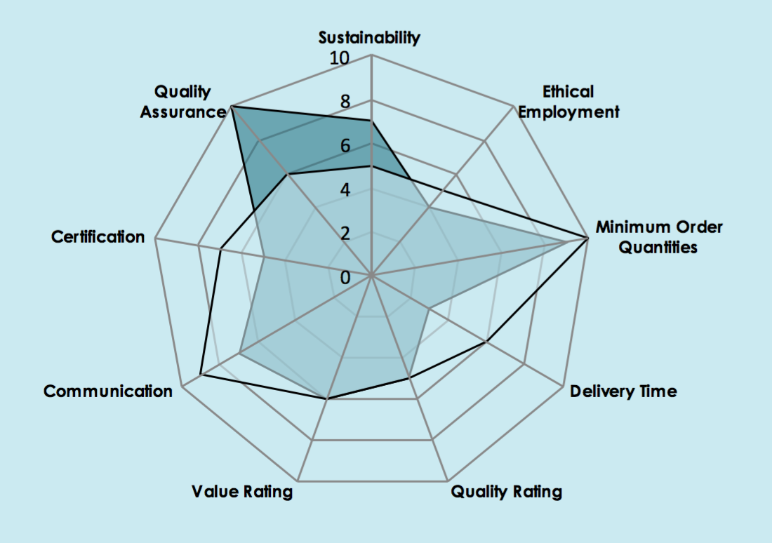
Home Page
Your SupplyCompass
Our 6 Stage Process
About Your Brand
Design Development
Factory Matching
Production
Product
No. of Styles
Order Quantities
We will only match you with factories that meet your ethos and credentials.
We believe that shared values are critical to finding your most trusted business partner
Budget
Company Values

Slide 10
Home Page
Show us what your brand emboides
Our 6 Stage Process
About Your Brand
Design Development
Factory Matching
Production
Product
No. of Styles
Order Quantities
Budget
Company Values
Upload Inspiration
Link your Instagram
Pinterest
Similar Products
Notes:
All of this info can go into the appendicies of the tech pack to allow us and the factories to know what kind of brand and company we are working with.
In the future this could also link to be almost like a Kickstarter type vetting that allows us to think about investing or linking with Investors to get in with these products at Seed stage.

Slide 11
Home Page
Based on your SupplyCompass we would recommend the following factories
Our 6 Stage Process
About Your Brand
Design Development
Factory Matching
Production
Product
No. of Styles
Order Quantities
Budget
Company Values
Profile 1
Profile 2
Profile 3

Slide 12
Home Page
Here is some of the things they have made before
Our 6 Stage Process
About Your Brand
Design Development
Factory Matching
Production
Product
No. of Styles
Order Quantities
Pic 1
Pic 1
Pic 1
Budget
Company Values
Pic 1
Pic 1
Pic 1

Slide 13
How Lets get your product Developed for production
Home Page
Our 6 Stage Process
About Your Brand
Design Development
Factory Matching
Production

Slide 14
What do you need help with?
Select what you need
Home Page
Our 6 Stage Process
About Your Brand
Design Development
Factory Matching
Production
Sizing
Patterns
Illustrations
Samples
Materials

Slide 15
What do you need help with?
Home Page
Our 6 Stage Process
About Your Brand
Design Development
Factory Matching
Production
Link with one of our Trusted Pattern makers or Illustrators
Sizing
Patterns
Illustrations
Samples
Materials
Person 1
Person 2
Person 3

Slide 16
Home Page
See Johns Structure
Our 6 Stage Process
About Your Brand
Design Development
Factory Matching
Production
Follow a similar process to Techpacker

Slide 17
Who would you like to request quotes from?
Home Page
Our 6 Stage Process
About Your Brand
Design Development
Factory Matching
Production
Or browse our extensive list of factories
Profile 1
Profile 2
Profile 3
Notes:
These Prices should be inclusive of Delivery against what we see as a standard unit rate, fed in from our logistics partenr

Slide 18
These Factories have come back with the following quotes
Home Page
Our 6 Stage Process
About Your Brand
Design Development
Factory Matching
Production
Profile 1
Profile 2
Profile 3
Unit Price
Unit Price
Unit Price
Delivery
Delivery
Delivery
Materials
Materials
Materials
Details
Request a Sample?
Details
Request a Sample?
Details
Request a Sample?
Notes:
These Prices should be inclusive of Delivery against what we see as a standard unit rate, fed in from our logistics partenr

Slide 19
Your Sample has arrived
Home Page
Our 6 Stage Process
About Your Brand
Design Development
Factory Matching
Production
What needs changing?
UPDATE THE TECH PACK
Detail 1
Detail 2
Detail 3
Detail 4

Slide 20
You are happy with your sample and ready for production
Home Page
Our 6 Stage Process
About Your Brand
Design Development
Factory Matching
Production
Generate Contract
Place Order
Manage the shipment
Order Date
Delivery Date

Slide 21
Home Page
Our 6 Stage Process
About Your Brand
Design Development
Factory Matching
Production
Track your shipment
Delivery Date

Slide 22
Home Page
Our 6 Stage Process
Want help selling your product?
About Your Brand
Design Development
Factory Matching
Production
List it on the Supplycompass Sellers Page

Slide 23
Starting A Project
Tech Pack Creator Page
Key Info
Name
Product Type
Category
Decription
Have you produced this before?
Budget for 1st batch of production
Target Manufacturing Cost
RRP
What Do you need help with? – Descriptions of each (6 stage Process)
Finding a Manufacturer
Pattern Making
Sampling
Tooling
Material Sourcing
Upload For All current product Information
Business Plan/ Product Summary
Branding Docs
Technical Drawings
SupplyCompass Specification – Auto recogniser that picks out information from their documents

